Slide 1

Parallel attention mechanism in NMT

Slide 2
Overview
1.Encoder – Decoder Model
2.Encoder – Decoder Model with attention

Slide 3
Encoder-Decoder Model
Encoder is responsible for encoding the entire sentence into context vector
Decoder is responsible for decoding the context vector generated from Encoder
Key is they are trained end to end rather than training the elements separately
Instead of using popular LTSM we use GRU(Gated Recurrent Unit)
GRU is better than LSTM as it is easy to modify and doesn't need memory units, therefore, faster to train than LSTM and give as per performance.

Slide 4
Why Attention Layer
If we are going through long sentences everything combined into one context vector will make neural network difficult to cope with
So For this reason attention mechanisms are introduced
Attention mechanism tells you alignment along with the meaning

Slide 5
Encoder-Decoder model with attention layer
This model with attention layer uses alignment and meaning to translate the sentence.
Let’s compare two models with diagrams

Slide 6
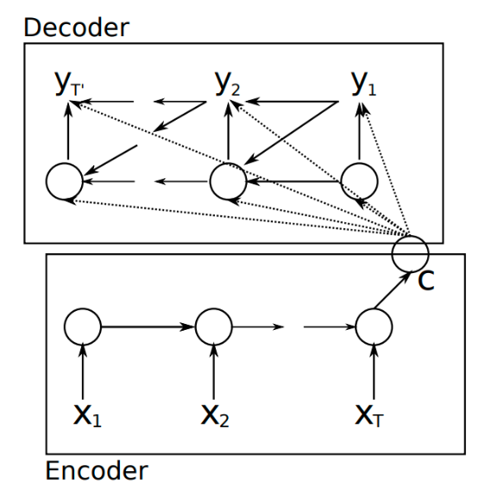
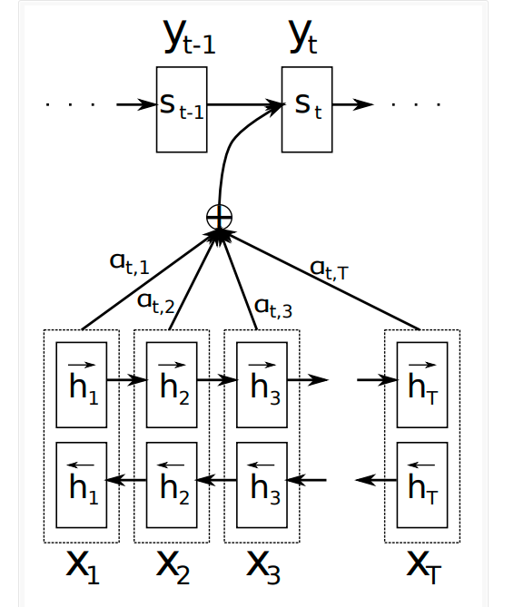
Comparison

Slide 7
Parallel attention Systems
Main reason behind this idea is that getting long term dependencies using LTSM or GRU takes more processing time because of loops and learning from previous steps.
So for this reason we need to reduce processing time.

Slide 8
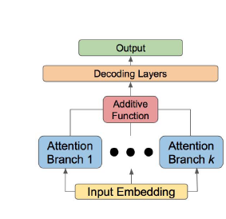
Basic idea of Parallel Attention Systems
This is the basic idea of parallel attention systems
Instead of stacking encoder layers we run them in parallel and feed into the decoder

Slide 9
Project goals and results
Compare the training time and performance between sequential and parallel model
In sequential model I ran 30000 sentences as training and it took 5-6 minutes to run
I couldn’t achieve coding the model in parallel. Though I have some results on the model I wrote and how good it is in traslation

Slide 10
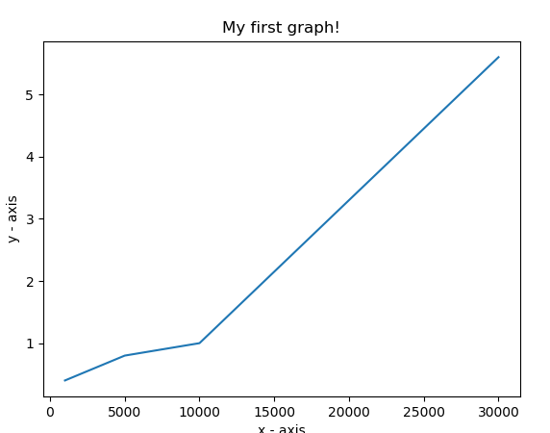
X axis represents no of sentences
Y axis represents time in minutes it took to train the model.
On average I got a bleu score of 0.75+- 0.05
I see it as a good model.

Slide 11
Thank You

